Slide 1
Deadlocks
References
  text: Tanenbaum ch.3

Slide 2
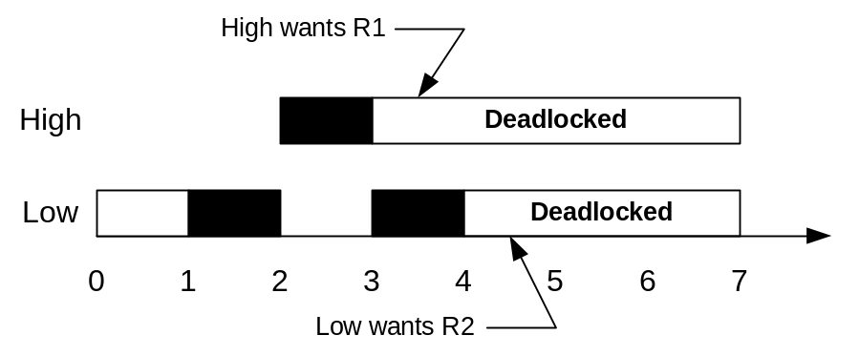
Deadly Embrace
Deadlock definition
  A set of process is dead locked if each process in the set is waiting for an event that only another process in the set can cause
Example

Slide 3
Necessary Conditions for Deadlock
1. Mutual exclusion
  only 1 process has access to the resource at a time
2. Hold and wait
  process currently holding resources can request new ones
3. No resource preemption
  resources granted cannot be forcibly taken way from a process
4. Circular wait
  a circular chain each of which is waiting for a resource held by the next member of the chain

Slide 4
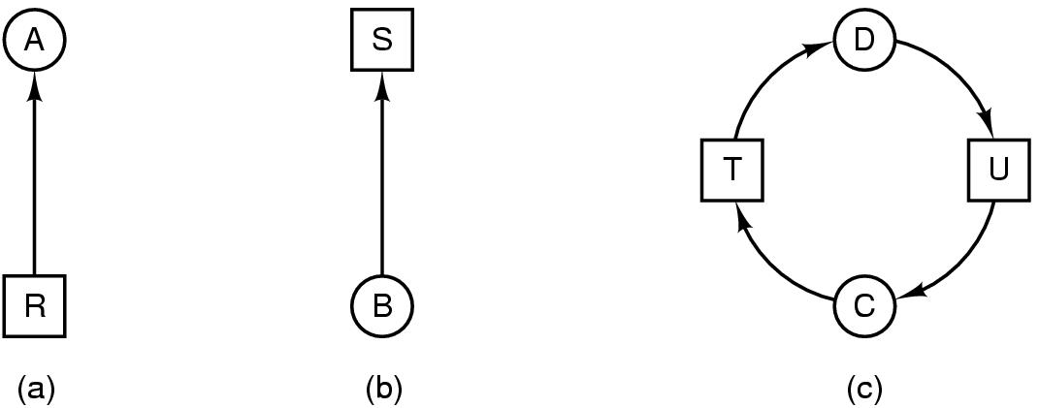
Deadlock Modeling
Modeling with directed graphs-Resource Allocation Graphs
  resource R assigned to process A
  process B is requesting/waiting for resource S
  process C and D are in deadlock over resources T and U

Slide 5
Strategies for dealing with Deadlocks
just ignore the problem altogether
detection and recovery
dynamic avoidance
  careful resource allocation
prevention
  negating one of the four necessary conditions

Slide 6
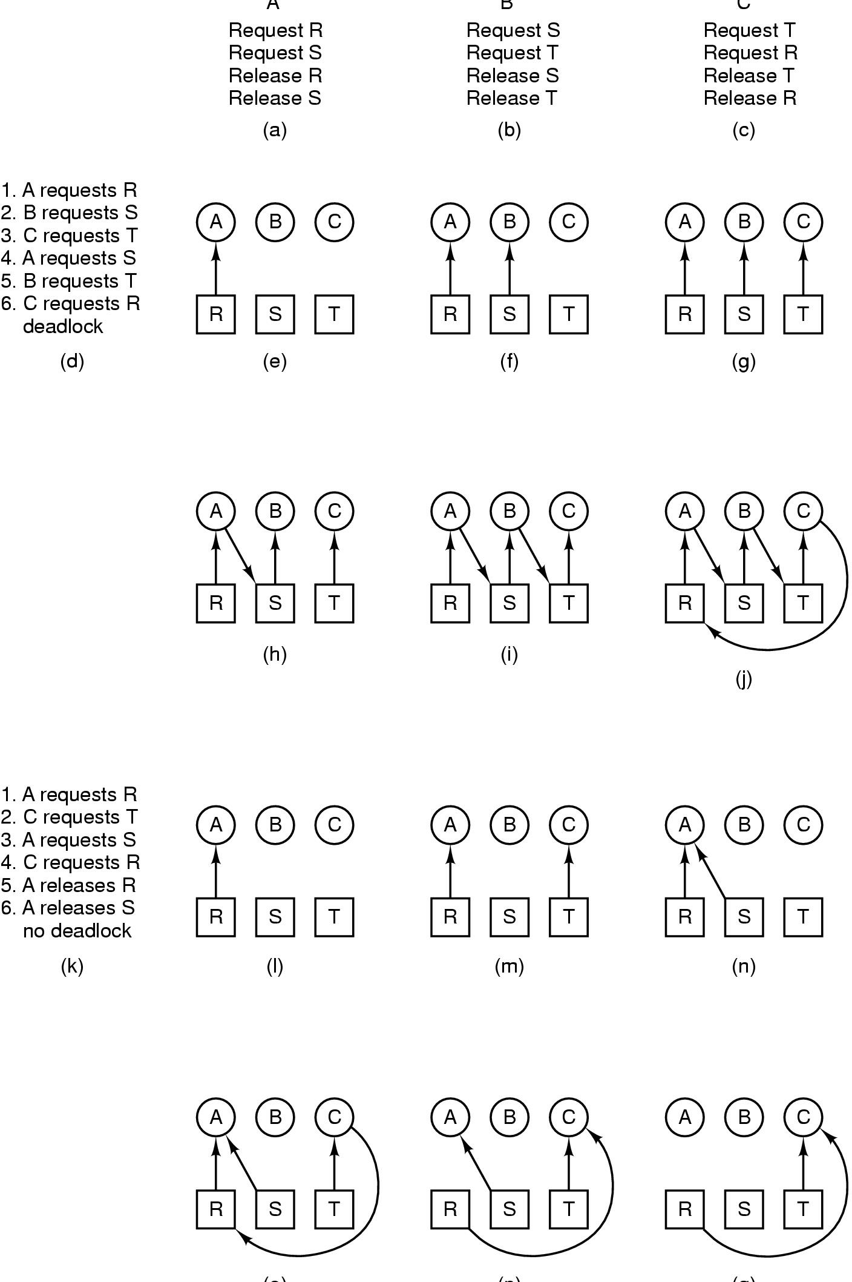
How Deadlock Occurs

Slide 7
How Deadlock can be Avoided

Slide 8

Deadlock Detection and Recovery
Detection with One Resource of Each type (e.g. 1 printer, 1 disk)
Construct the resource allocation graph and look for cycles. Any process that is part of a cycle is deadlocked.
D, E, G are deadlocked
T

Slide 9
Algorithm to Detect Deadlocks
L: data structure
of a list of nodes
Loop for each node in graph, initialize L=[], arcs unmarked
Add current node to L
Current node = last node
Node
appears
twice?
last node=
initial node?
yes
yes
Any unmarked
outgoing arc?
yes
Mark the arc and follow it to next node
Found
deadlock
Found
no deadlock
End
Remove the node from L
End

Slide 10
Example
From node R From node B
L=[] L=[], L=[B],...
L=[R] L=[B,T,E,V,G,U,D]
L=[R,A,S] L=[B,T,E,V,G,U,D,S]
L=[R,A] L=[B,T,E,V,G,U,D]
L=[R] L=[B,T,E,V,G,U,D,T]
no deadlock from R found deadlock

Slide 11
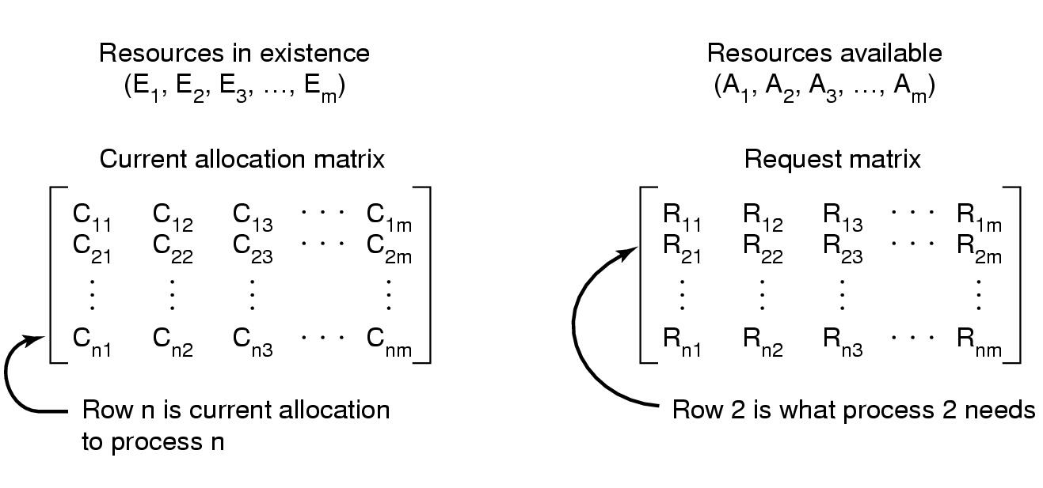
Deadlock Detection and Recovery (cont’d)
Detection with Multiple Resource of Each Type (e.g. 2 printers etc)
n
∑C_{ij} +A_{j} = E_{j}
_{i=1}

Slide 12
Algorithm to Detect Deadlocks
Go through every unmarked process, for i^{th} process
Mark process
yes
A = A + C_{i}
R_{i} < A ?
Pick another
process
Deadlock occurs if
there are unmarked processes
end
Vector comparison:
R_{i} < A means for all j, R_{ij} < A_{j}

Slide 13
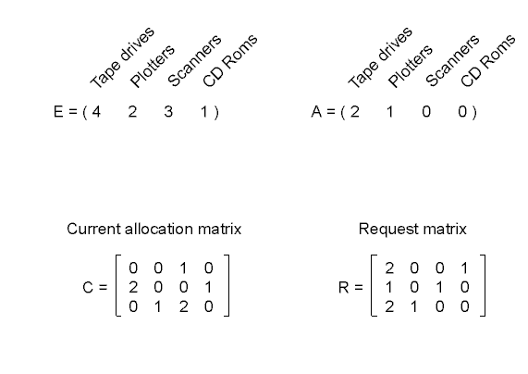
Deadlock Detection Example
Vector comparison R_{i} < A
processes 1 and 2 cannot be satisfied
process 3 is satisfied and A is updated A=A + C₃ =(2 2 2 0)
process 1 cannot be satisfied, but process 2 is satisfied. A is updated to A=(4 2 2 1)
process 1 can be satisfied and there is no deadlock in system

Slide 14
Deadlock Recovery
Through Preemption
  take a resource from some other process
  depends on nature of the resource
Through Rollback
  checkpoint a process periodically
  use this saved state
  restart the process if it is found deadlocked
Through Killing Processes
  crudest but simplest way to break a deadlock
  kill one of the processes in the deadlock cycle
  the other processes get its resources
  choose process that can be rerun from the beginning

Slide 15
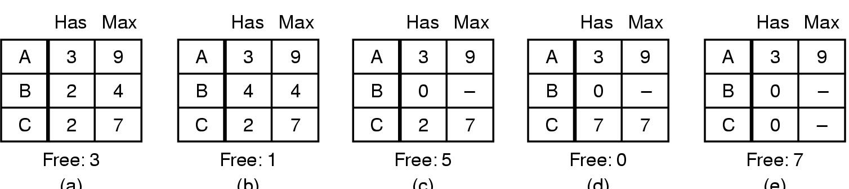
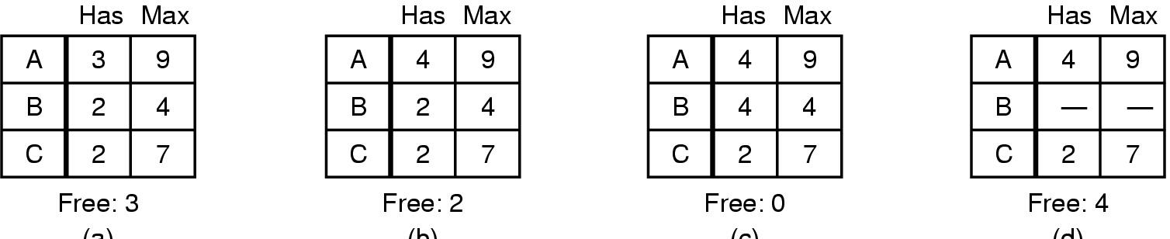
Deadlock Avoidance
Safe and Unsafe States
  A safe state is not deadlocked and there is some scheduling order that every process can run to completion
  Safe state example (10 available instances of a resource)
  Unsafe state example (10 available instances of a resource)

Slide 16
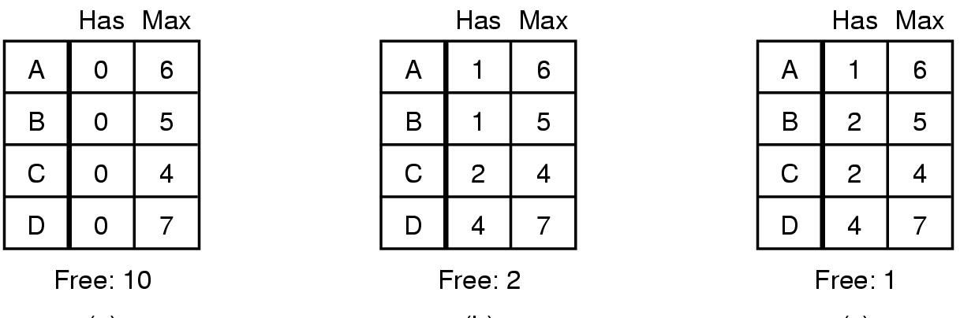
Banker’s Algorithm
Check to see if granting the request for a resource leads to an unsafe state. If it does, the request is denied.
A single resource example:
Safe
Safe
Unsafe
Schedule
order:
A, B, C, D
C, B, A, D
Cannot schedule
any task

Slide 17
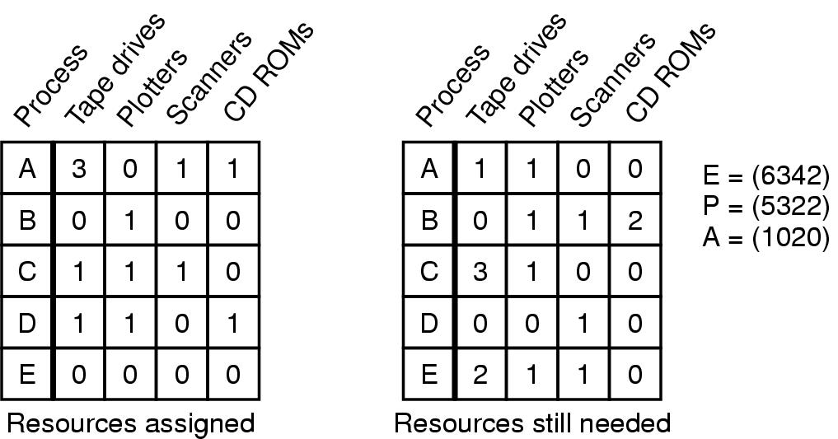
Banker’s Algorithm for Multiple Resources
E: existing
P: possessed
A: available
“C”
“R”
(Current allocation)
(Remaining Needs)
Use the same deadlock detection algorithm
R_{i} < A, if true, A = A + C_{i}

Slide 18
Banker’s Algorithm for Multiple Resources (cont’d)
4
5
3
E: existing
P: possessed
A: available
1
2
“C”
“R”
(Current allocation)
(Remaining Needs)
Start Process D. After completion, P=(4,2,2,1), A=(2,1,2,1)
Start Process E. After completion, P=(4,2,2,1), A=(2,1,2,1)
Start Process C. After completion, P=(3,1,1,1), A=(3,2,3,1)
Start Process A. After completion, P=(0,1,0,0), A=(6,2,4,2)
Start Process B. After completion, P=(0,0,0,0), A=(6,3,4,2)
A safe state
No deadlock

Slide 19
Deadlock Prevention
Attack the mutual exclusion condition
  use spooling
Attack the hold and wait condition
  request all resources initially
Attack the no preemption
  take resources away
Attack the circular wait condition
  order resources numerically

